Slide 1
Nucleon Structure with Jefferson Lab at 12 GeV Upgrade
Latifa Elouadrhiri
Jefferson Lab
Notes:
The Jefferson Lab site is currently undergoing significant changes in preparations for the energy upgrade to 12 GeV. This shows the site in a birds eye view.

Slide 2

12 GeV Upgrade Project
Upgrade is designed to build on existing facility: vast majority of accelerator and experimental equipment have continued use
New Hall
Upgrade arc magnets
and supplies
Add 5 cryomodules
20 cryomodules
CHL upgrade
Maintain capability to deliver lower pass beam energies: 2.2, 4.4, 6.6….
Add arc
20 cryomodules
The completion of the 12 GeV Upgrade of CEBAF was ranked the highest priority in the 2007 NSAC Long Range Plan.
Add 5 cryomodules
Scope of the project includes:
Doubling the accelerator beam energy
New experimental Hall and beamline
Upgrades to existing Experimental Halls
Enhanced capabilities
in existing Halls

Slide 3
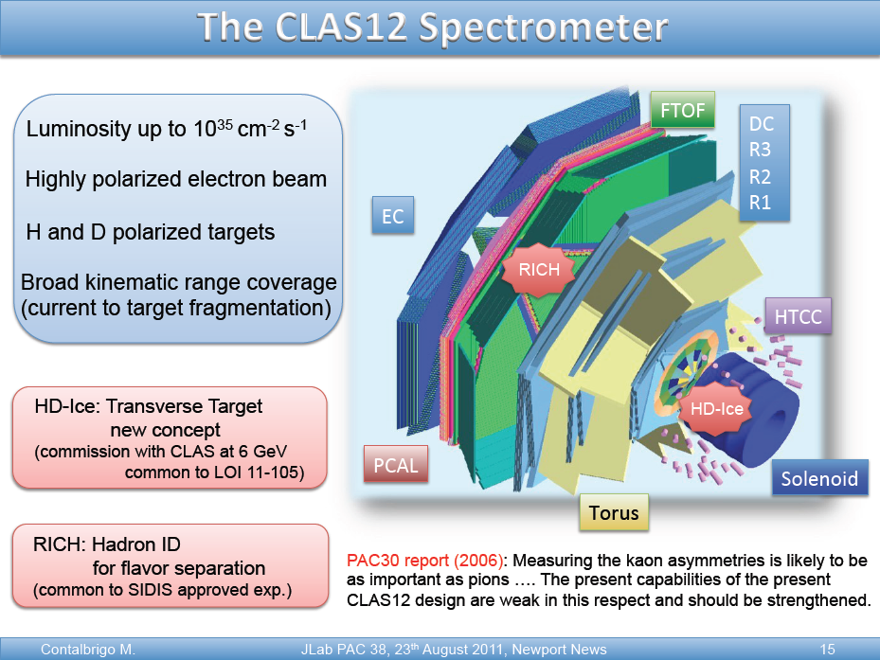
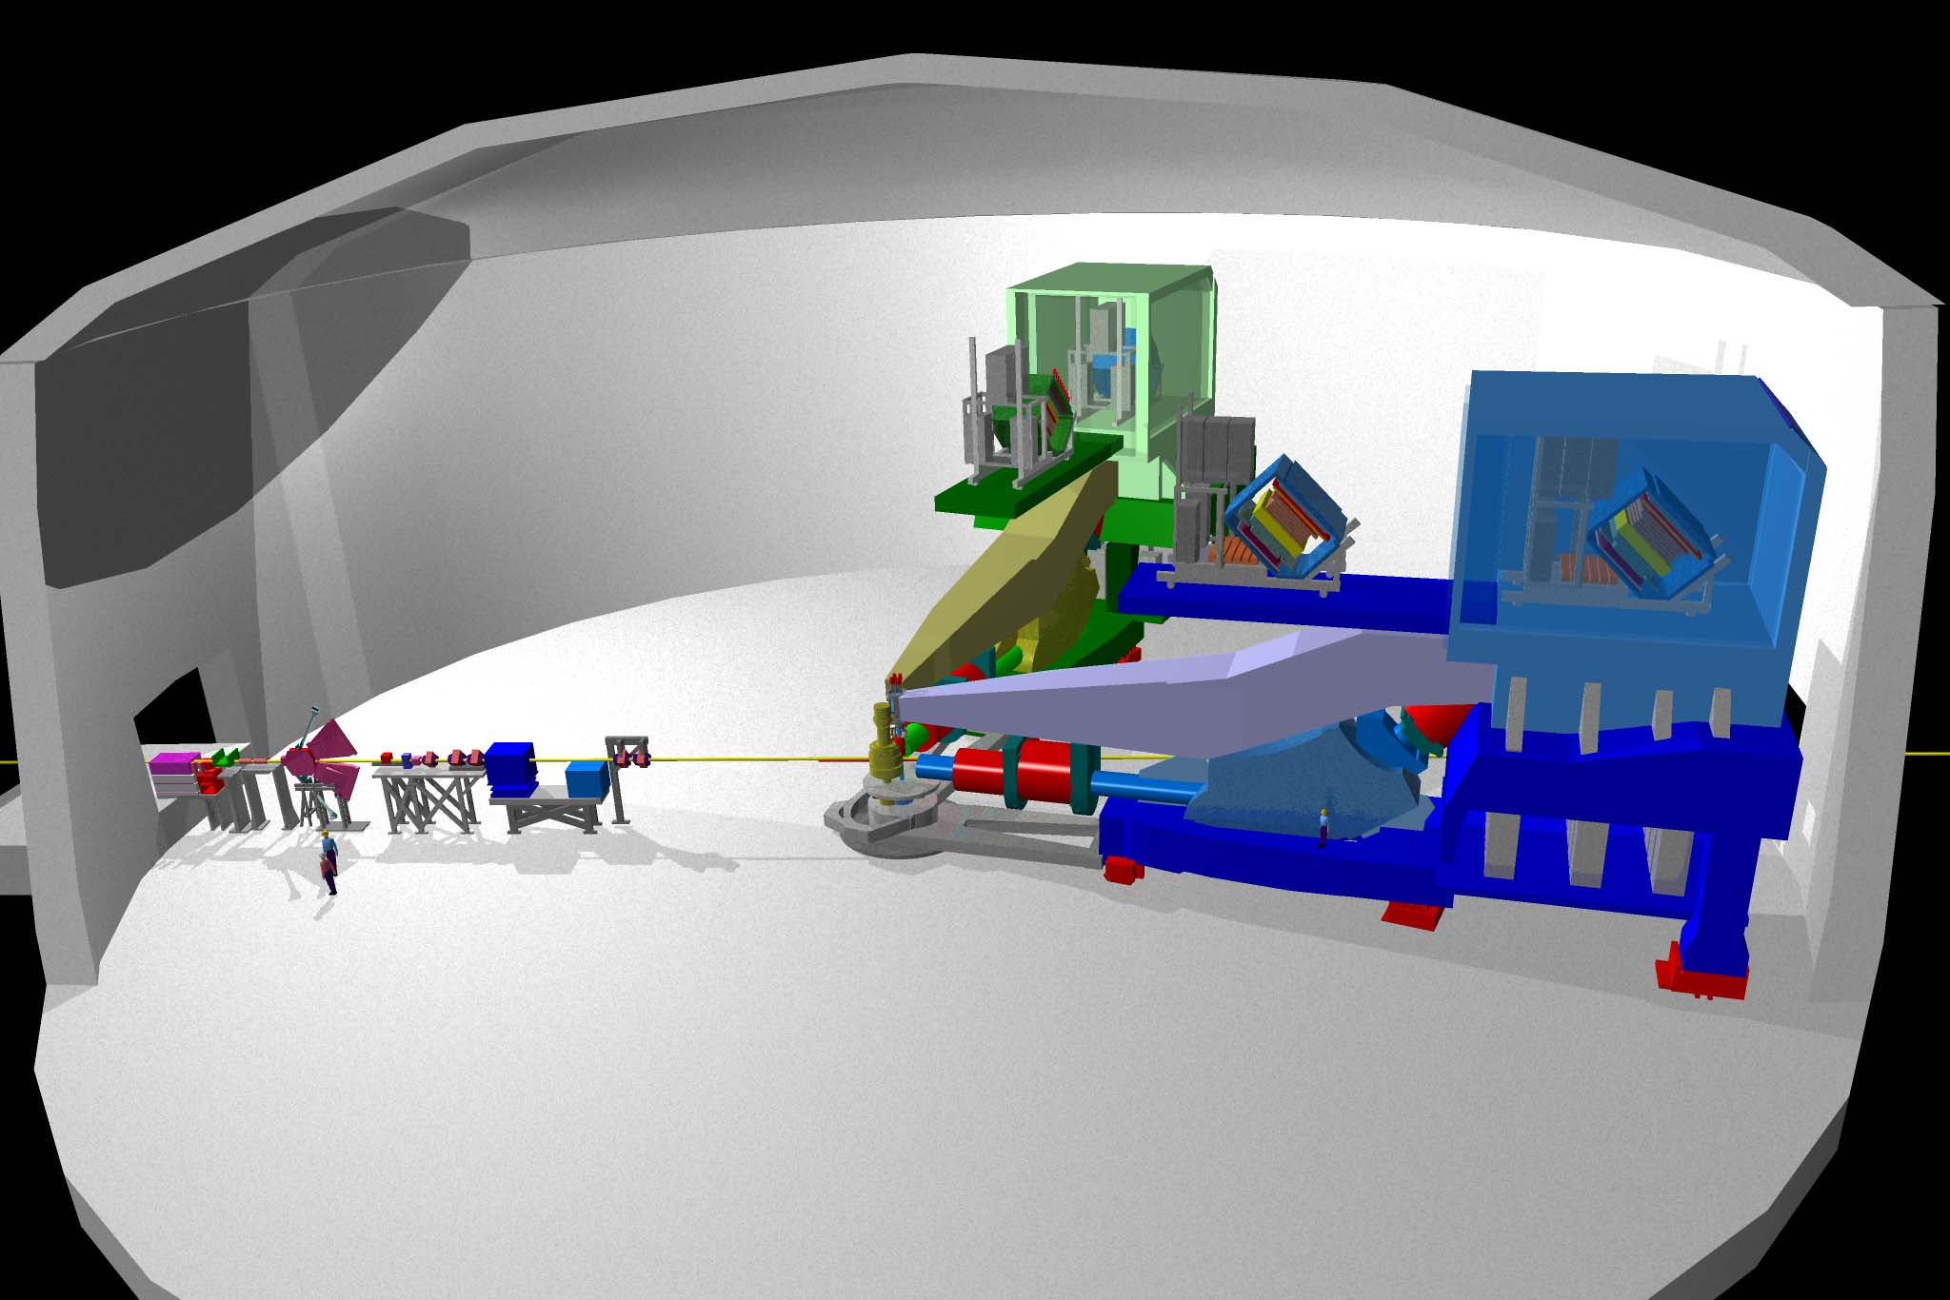
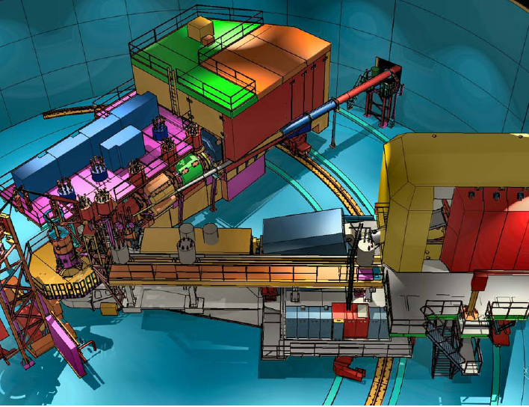
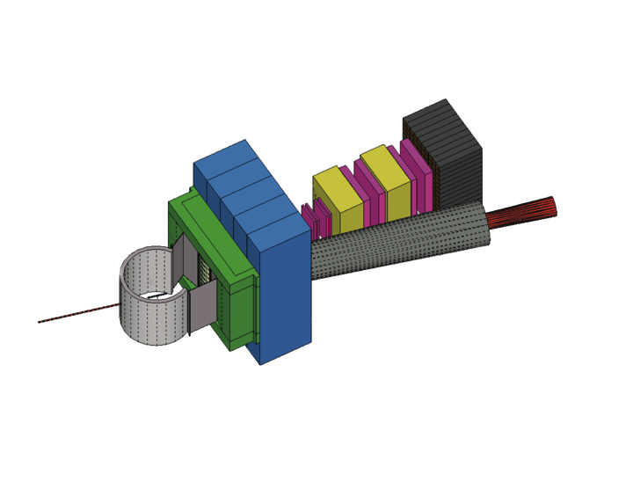
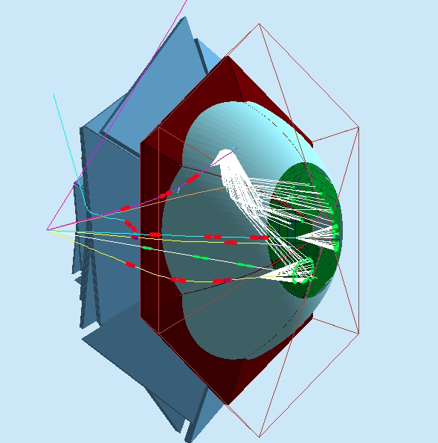
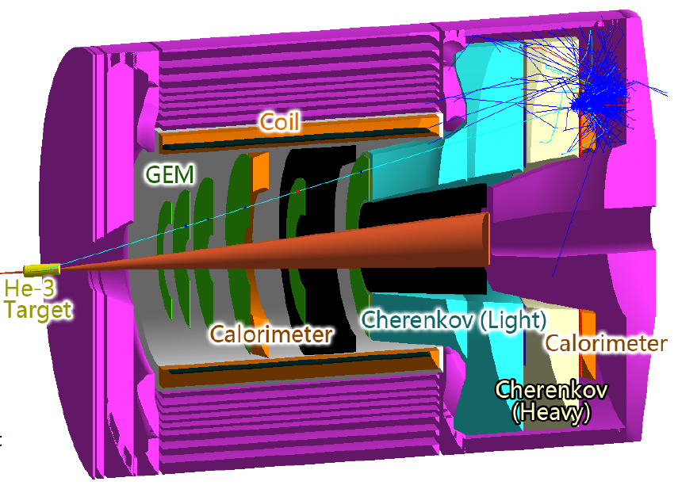
Base equipment & proposed equipment
JLab 12 GeV base equipment
CLAS12
SHMS
HMS
additional equipment (proposed)
SBS-Hall A
Hadron calorimeter
CLAS12 RICH
SOLID - Hall A
Tracker
Scattering chamber
CH2 analyzer
Beam line Pb shield

Slide 4
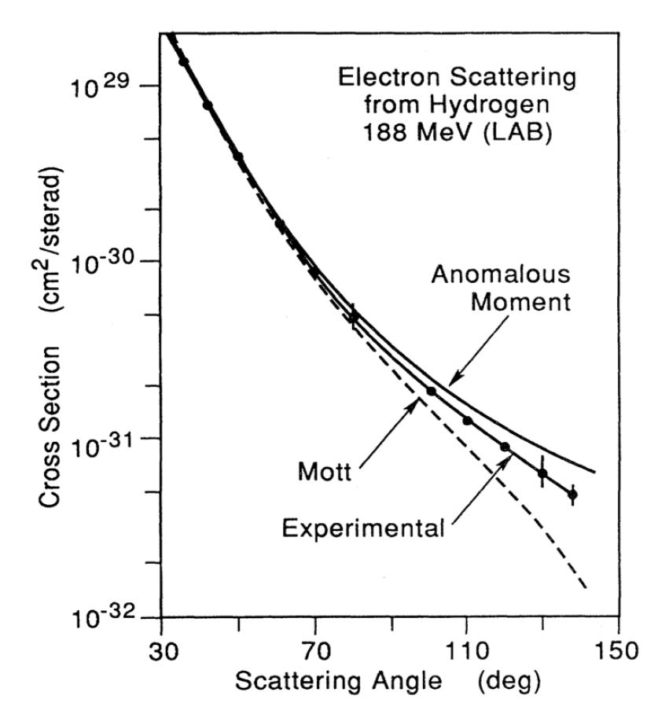
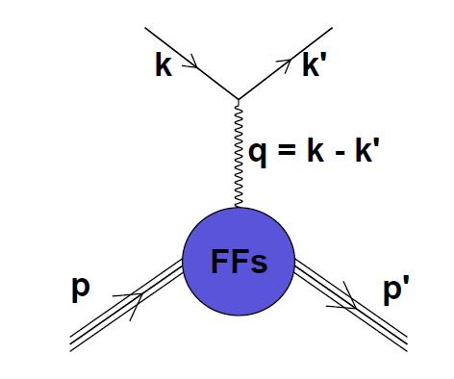
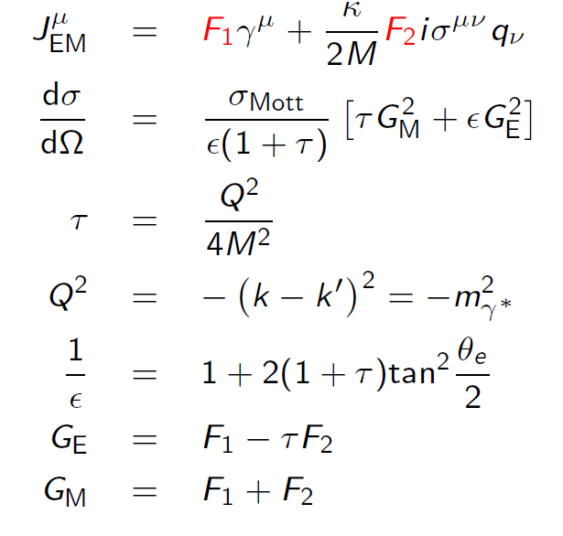
Elastic Scattering Form Factors
Probing deeper using virtual photons
Hofstadter Nobel Prize 1961
The best fit inthis figure indicates
An arms radius close to 0.74 x 10-33cm
Imaging in transverse impact parameter

Slide 5
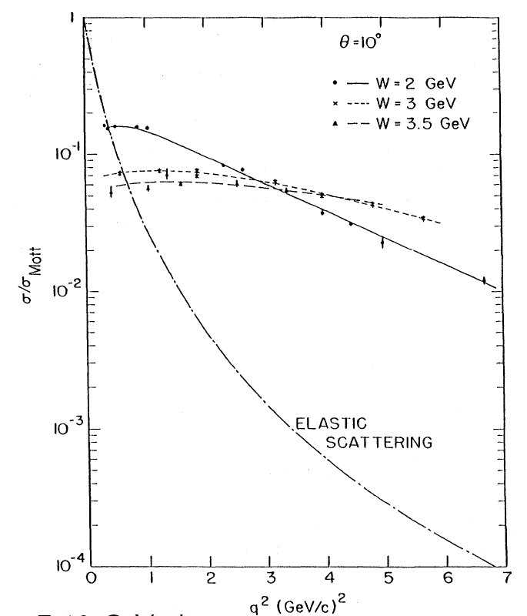
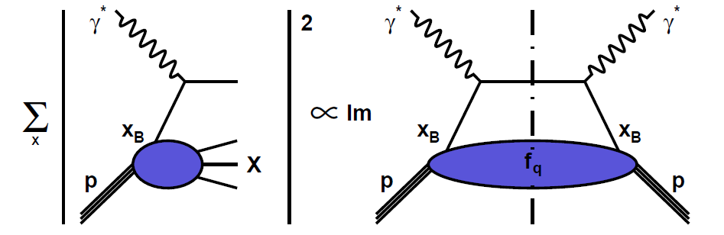
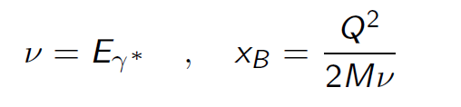
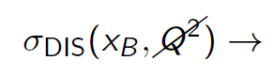
Deeply Inelastic Scattering Parton Distributions
Optical theorem
The Total cross section is given by the imaginary of the forward amplitude
Scaling, point-like constituents
Discovery of quarks, SLAC-MIT group, 7-18 GeV electron
Friedman, Kendall Taylor, Nobel prize 1990
1-D distribution in longitudinal momentum space

Slide 6
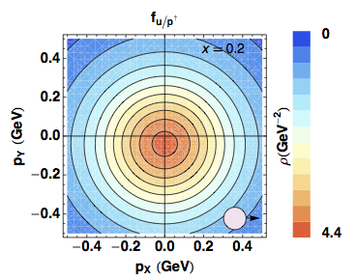
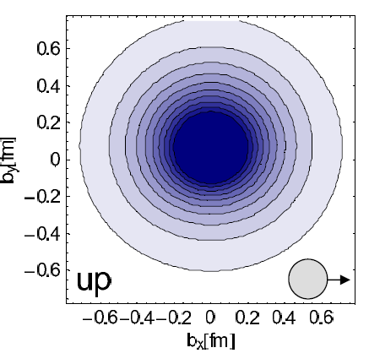
Quantum phase-space distributions of quarks
W_{p}^{q}(x,k_{T},r) “Mother” Wigner distributions
Probability to find a quark q in a nucleon P with a certain polarization in a position r & momentum k
d³r
d²k_{T}
[Wigner (1932)]
[Belitsky, Ji, Yuan (04)]
[Lorce’, BP (11)]
QM
QFT (Breit frame)
QFT (light cone)
TMD PDFs: f_{p}^{u}(x,k_{T}),…
GPDs: H_{p}^{u}(x,ξ,t), …
Semi-inclusive measurements
Momentum transfer to quark
Direct info about momentum distribution
Exclusive Measurements
Momentum transfer to target
Direct info about spatial distribution
d²k_{T}
ξ=0,t=0
PDFs f_{p}^{u}(x),…
Contalbrigo M.
6

Slide 7
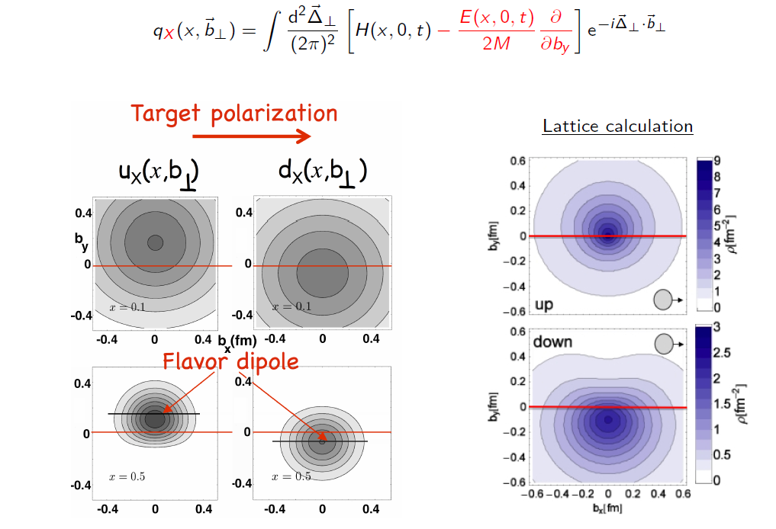
GPDs and transverse imaging

Slide 8
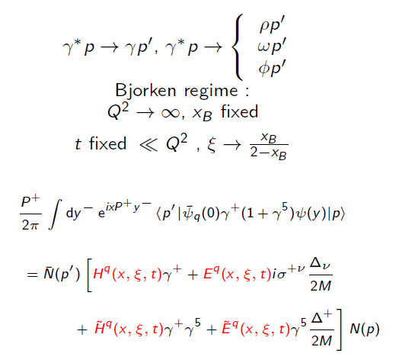
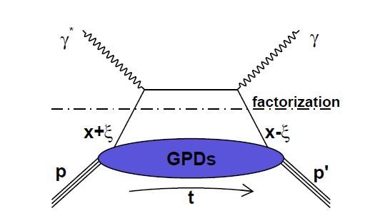
Deep Virtual Compton Scattering (DVCS)
and Generalized Parton Distributions
x: average fraction of quark longitudinal momentum
:fraction of longitudinal momentum transfer
~
~
H, E, H, E : Generalized Parton Distributions (GPDs)
3-D Imaging conjointly in transverse impact parameter and longitudinal momentum

Slide 9
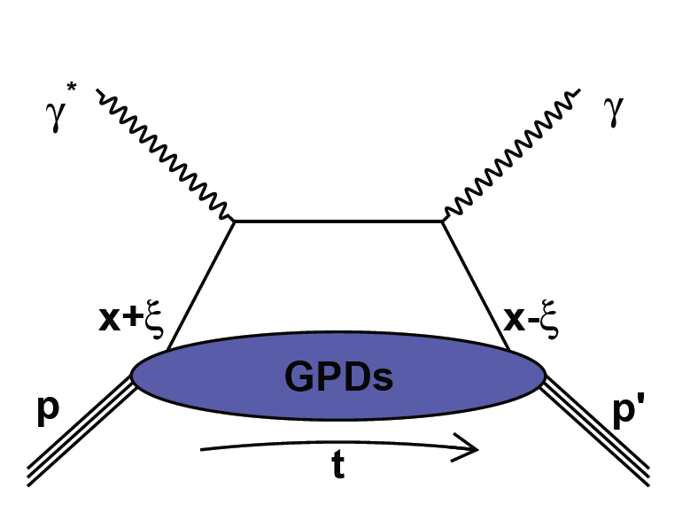
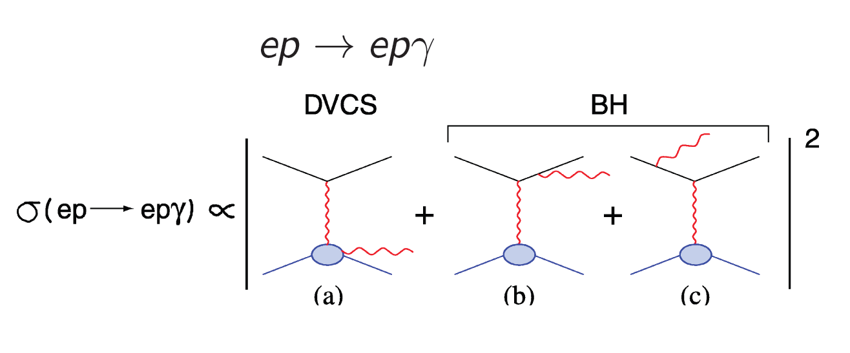
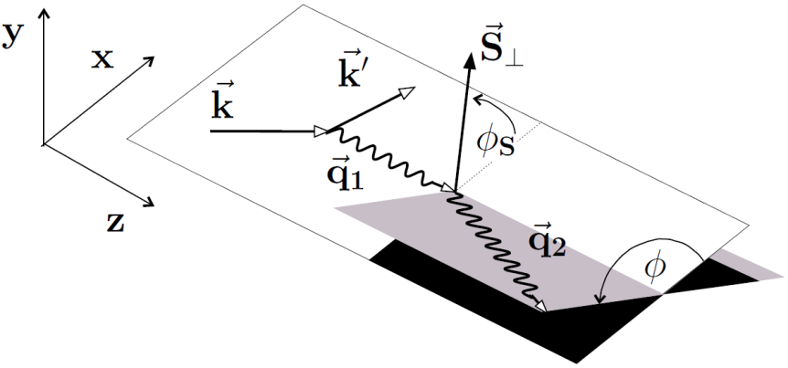
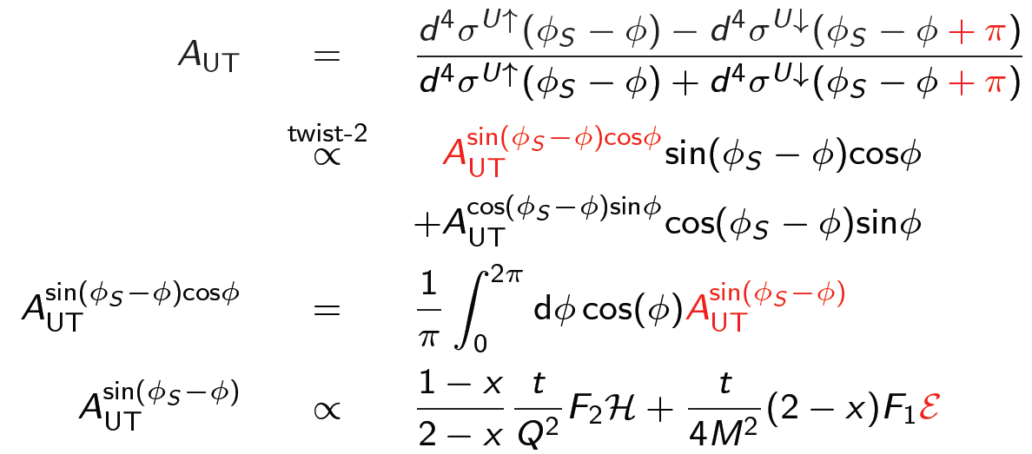
Deeply Virtual Compton Scattering (DVCS)
The Cleanest Probe at low medium energies

Slide 10
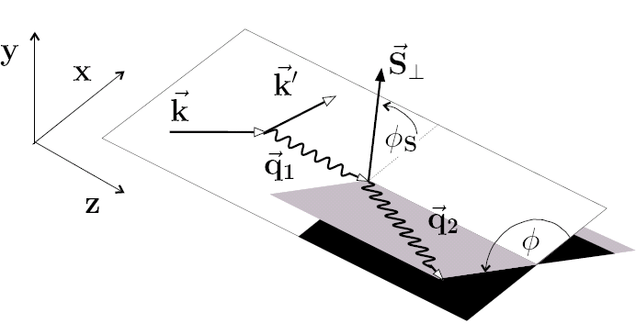
A path towards extracting GPDs
σ⁺ − σ⁻
σ⁺ + σ⁻
Δσ
2σ
ξ ~ x_{B}/(2-x_{B})
A =
=
k = t/4M²
Polarized beam, unpolarized target:
~
H(ξ,t)
Δσ_{LU} ~ sinφ {F₁H + ξ(F₁+F₂)H +kF₂E}dφ
Unpolarized beam, longitudinal target:
~
~
Δσ_{UL} ~ sinφ {F₁H+ξ(F₁+F₂)(H +ξ/(1+ξ)E)}dφ
H(ξ,t)
Unpolarized beam, transverse target:
E(ξ,t)
Δσ_{UT} ~ cosφsin(φ_{s}-φ){k(F₂H – F₁E)}dφ
Unpolarized total cross section:
Separates h.t. contributions to DVCS
Re(T^{DVCS})
Notes:
The most direct way of accessing GPDs is through polarization measurements. Using polarized electron beams we can measure the cross section difference for opposite electron helicities. The cross section difference depends on the 3 GPDs H, H-tilde, and E. The kinematical factors suppress the contributions of H-tilde and of E so that the beam spin asymmetry is dominated by GPD H. For longitudinally polarized target the asymmetry is dominated by H-tilde as H and E are kinematically suppressed at not too large xi giving access to H-tilde. With a transversely polarized target one has access to a combination of H and E. With these 3 measurements we are able to disentangle 3 GPDs H, E, H-tilde.

Slide 11
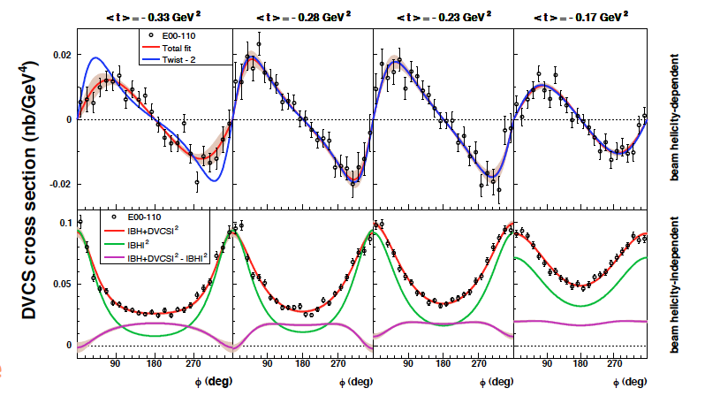
Hall A DVCS/BH cross section on proton
C. Muñoz et al., Phys. Rev. Lett. 97 (2006) 262002
High statistics in small range in Q², x_{B}, t
Verify Bjorken scaling in small Q² range

Slide 12
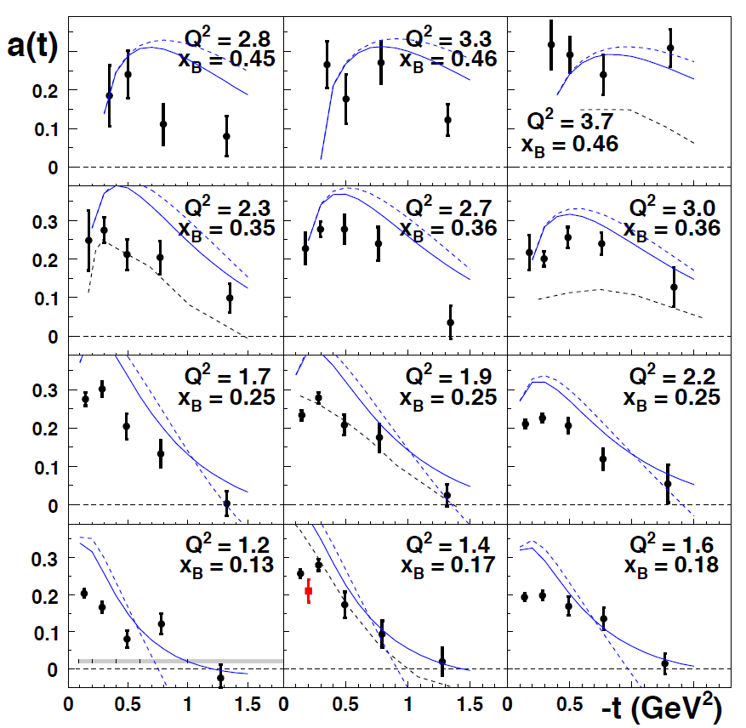
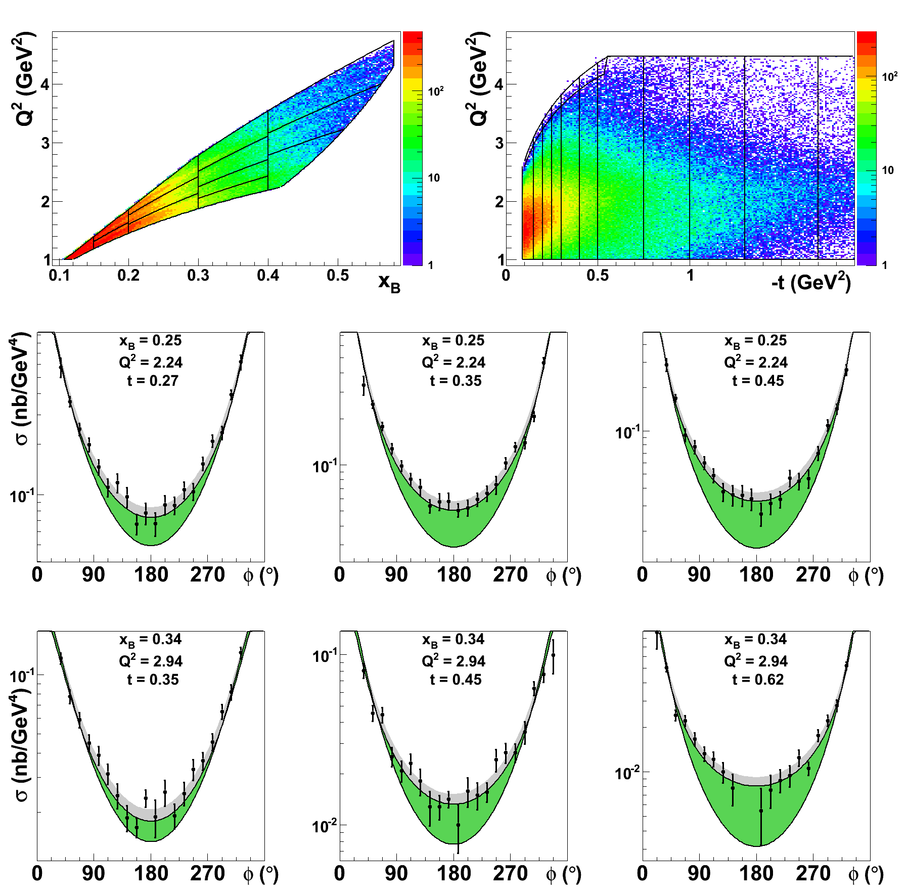
CLAS Proton BSA and Cross section
F.-X. G. et al., PRL 100(2008)162002
More than 3k φ-bins
Quantitative constraints on parameters

Slide 13
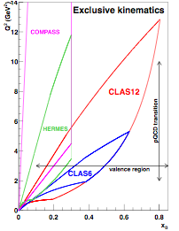
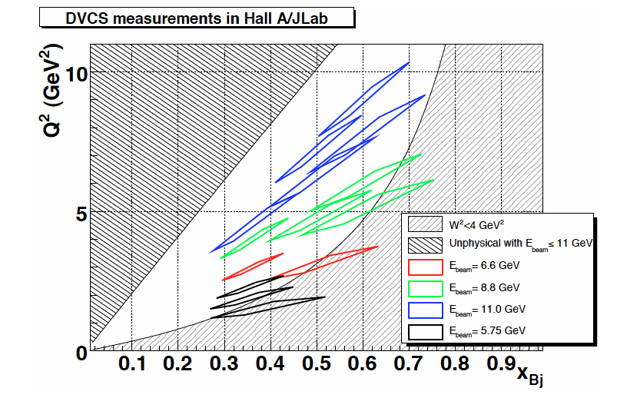
GPDs in DVCS experiments at JLab12 (Hall A & B)
~
γ, π⁰ (A) proton
γ, π⁰ (B) proton
γ, π⁰ (B) neutron
UP
LP
TP
H, H, E
~
H, H, E
γ, π⁰ (NH₃) (B) proton
E, H
γ, π⁰ (HD) (B) proton

Slide 14
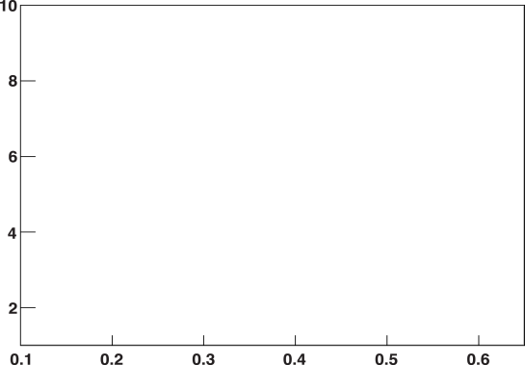
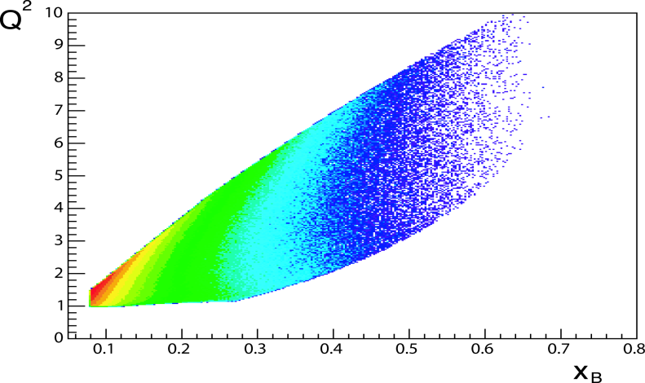
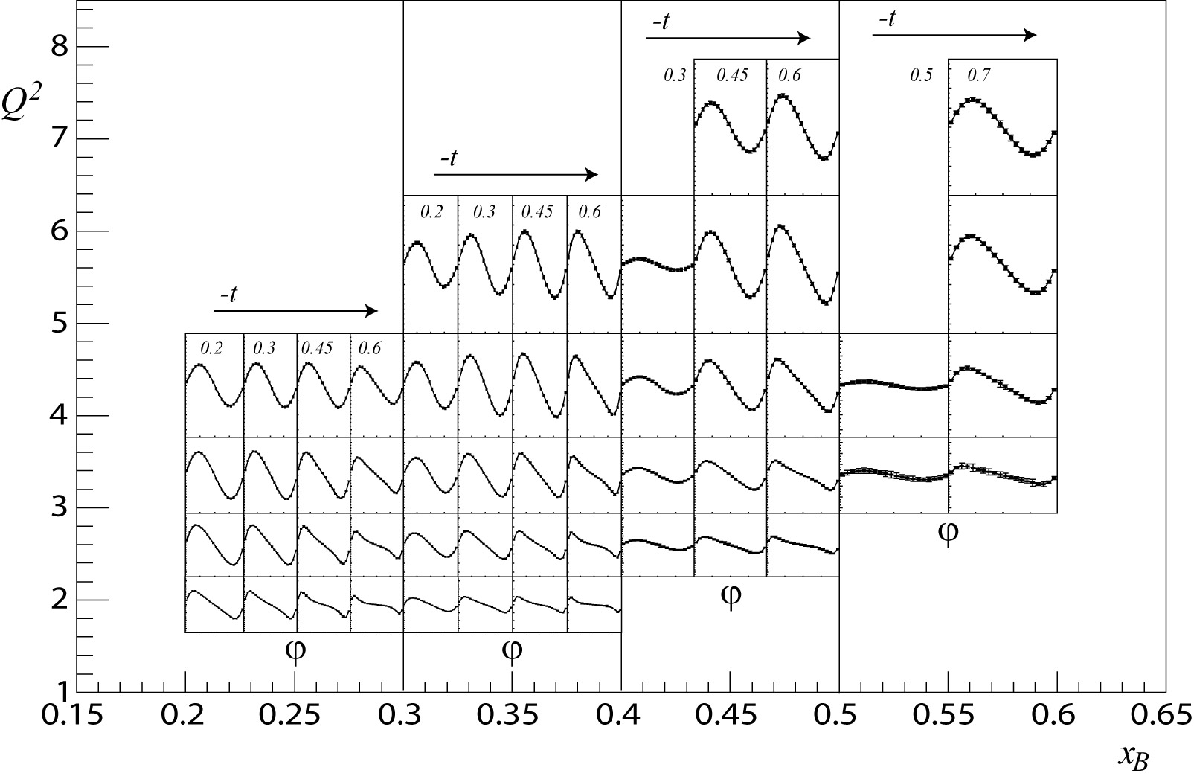
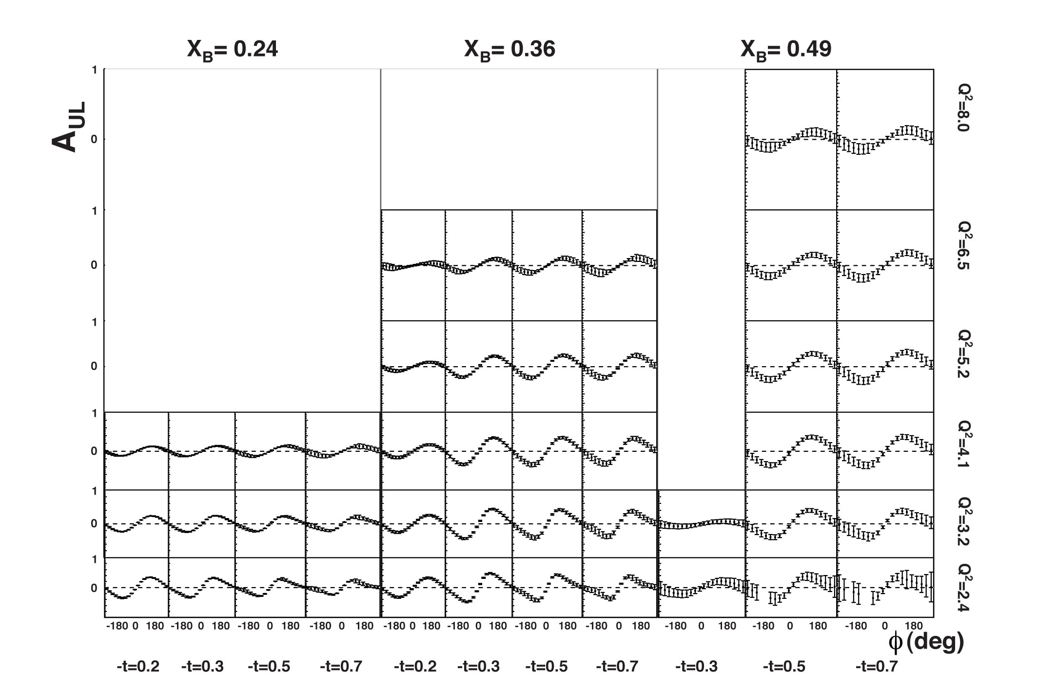
CLAS12 approved DVCS program
E=11 GeV
x_{B}/Q² acceptance
with CLAS12
Q² (GeV²)
x_{B}
80 days of beam time
85% beam pol.
10³⁵ cm⁻²s⁻¹ luminosity
1 < Q² < 10 GeV²
0.1 < x_{B} < 0.65
-t_{min} < -t < 2.5 GeV
120 days of beam time
P_{beam} = 85%, P_{target} = 80%
10³⁵ cm⁻²s⁻¹ luminosity
1 < Q² < 10 GeV²
0.1 < x_{B} < 0.65
-t_{min} < -t < 2.5 GeV²

Slide 15
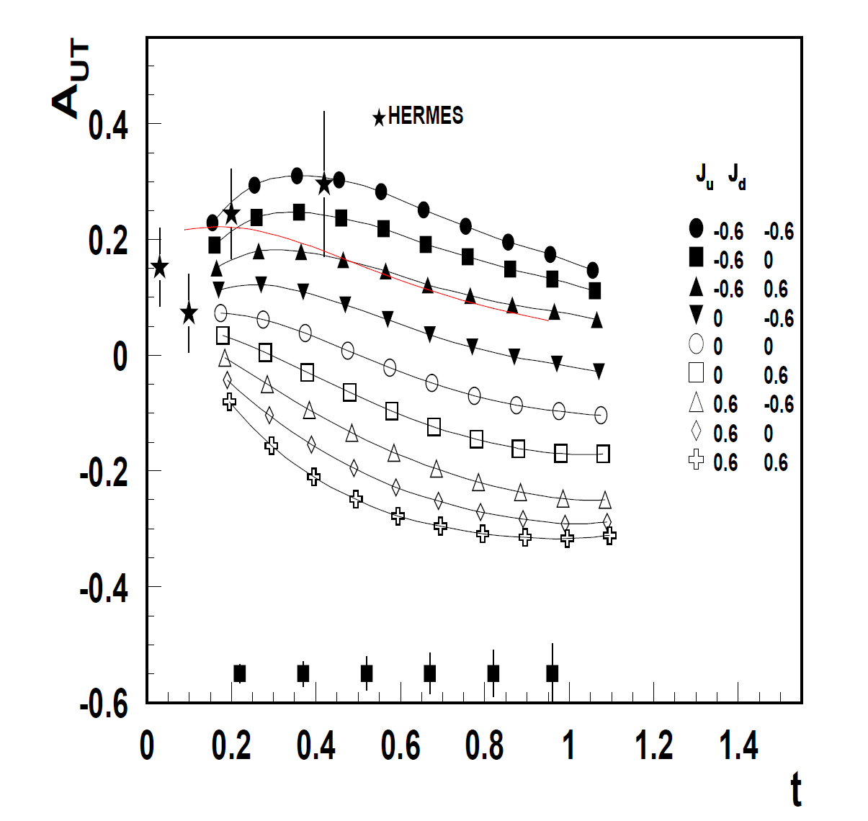
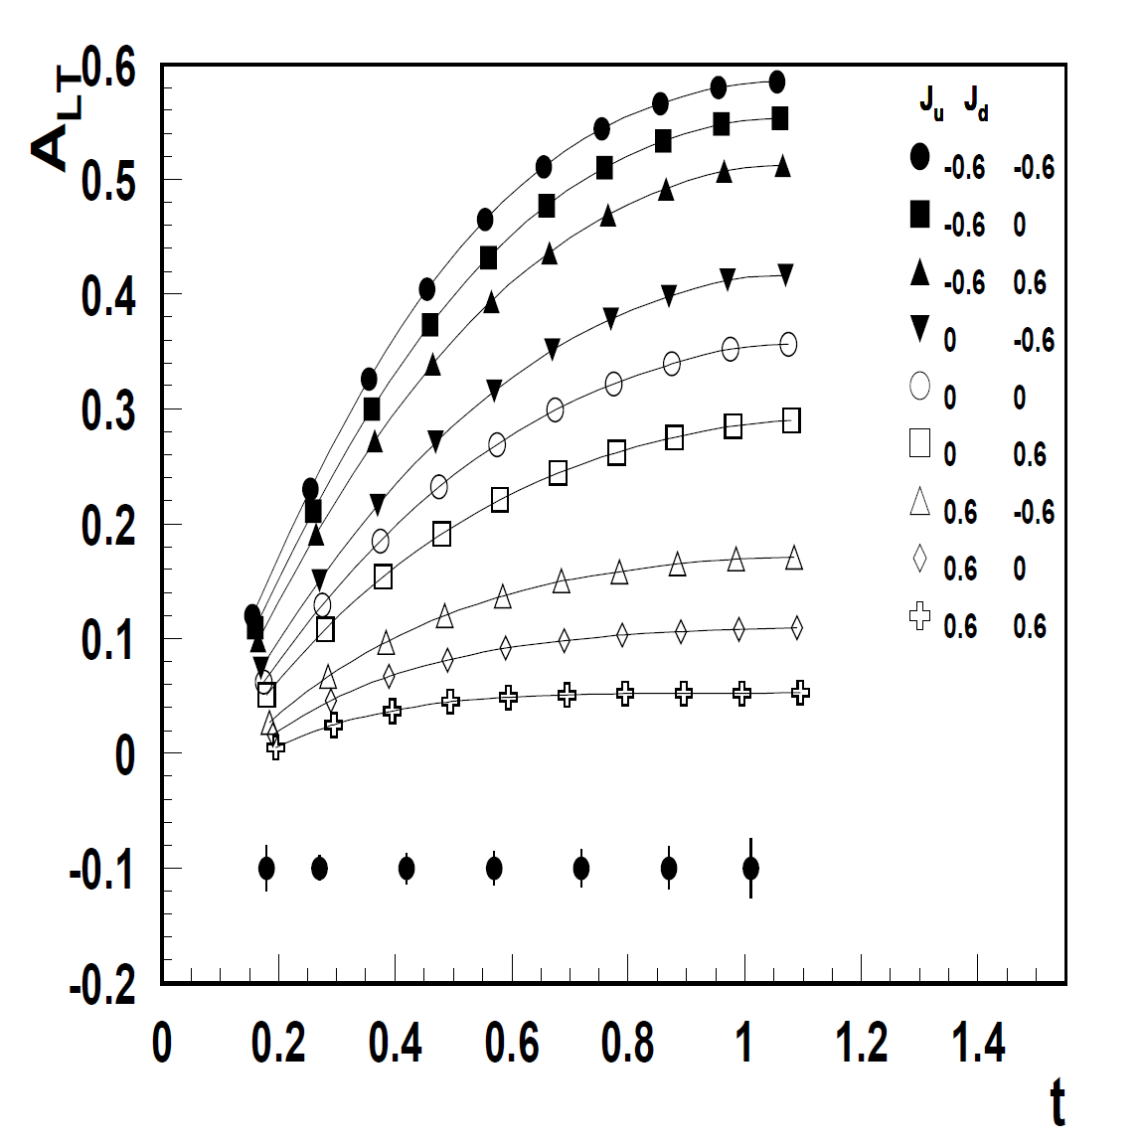
Transverse target spin asymmetry A_{UT}
High precision data over a large phase space will allow us to measure the CFF-E
and constrain the quark angular momentum in the proton, Jq

Slide 16
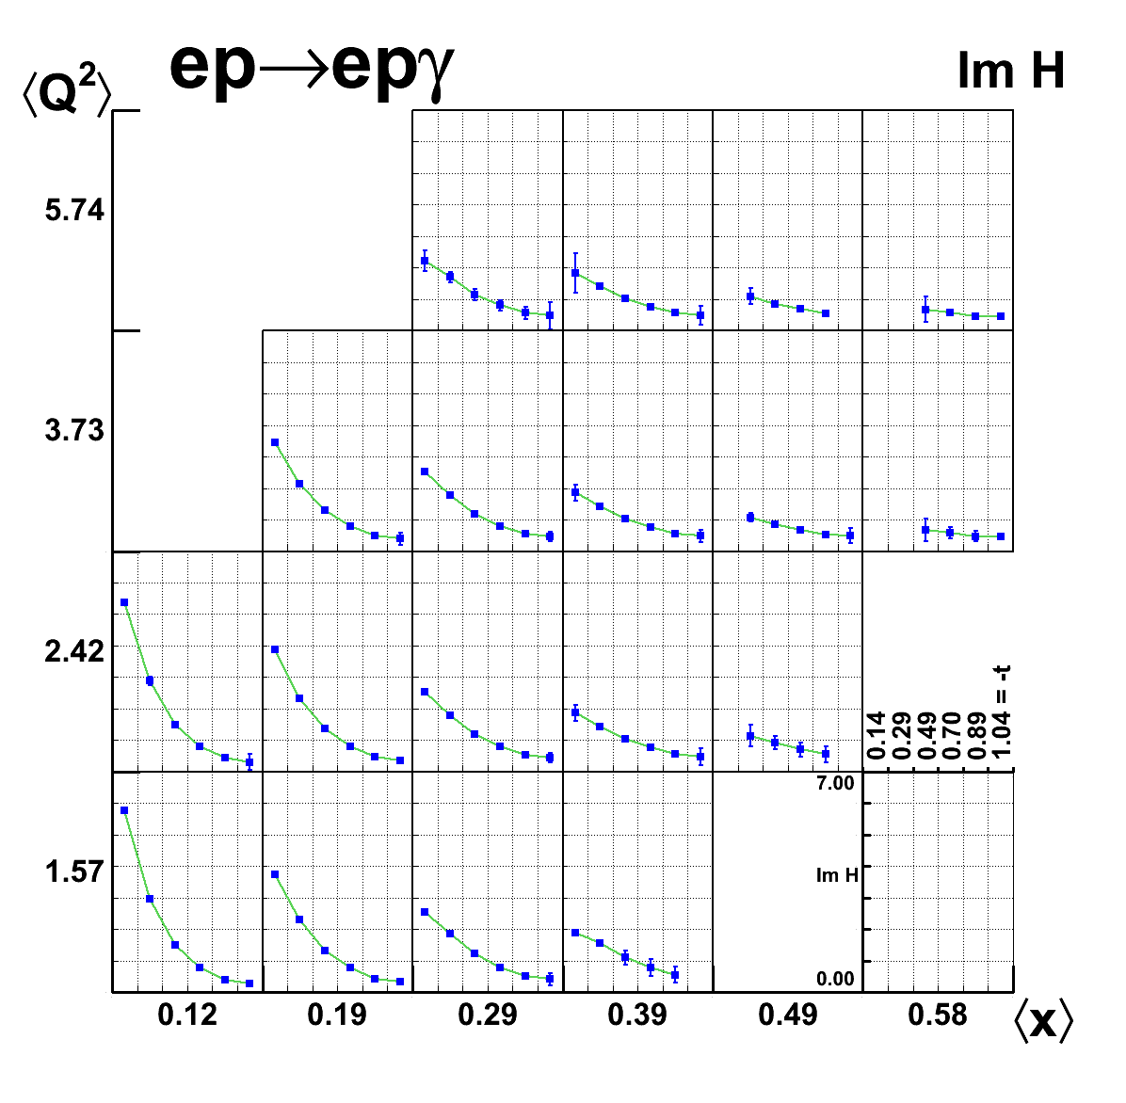
GPD Extraction – Im H
Model-independent fit, at fixed x_{B}, t and Q²,of DVCS observables

Slide 17
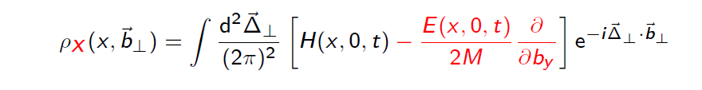
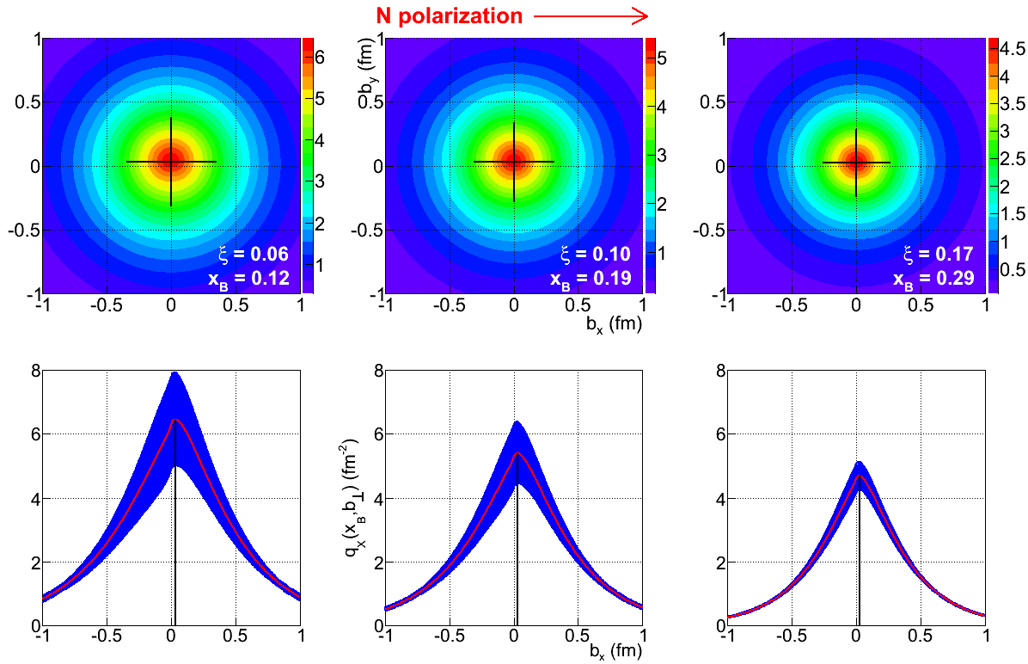
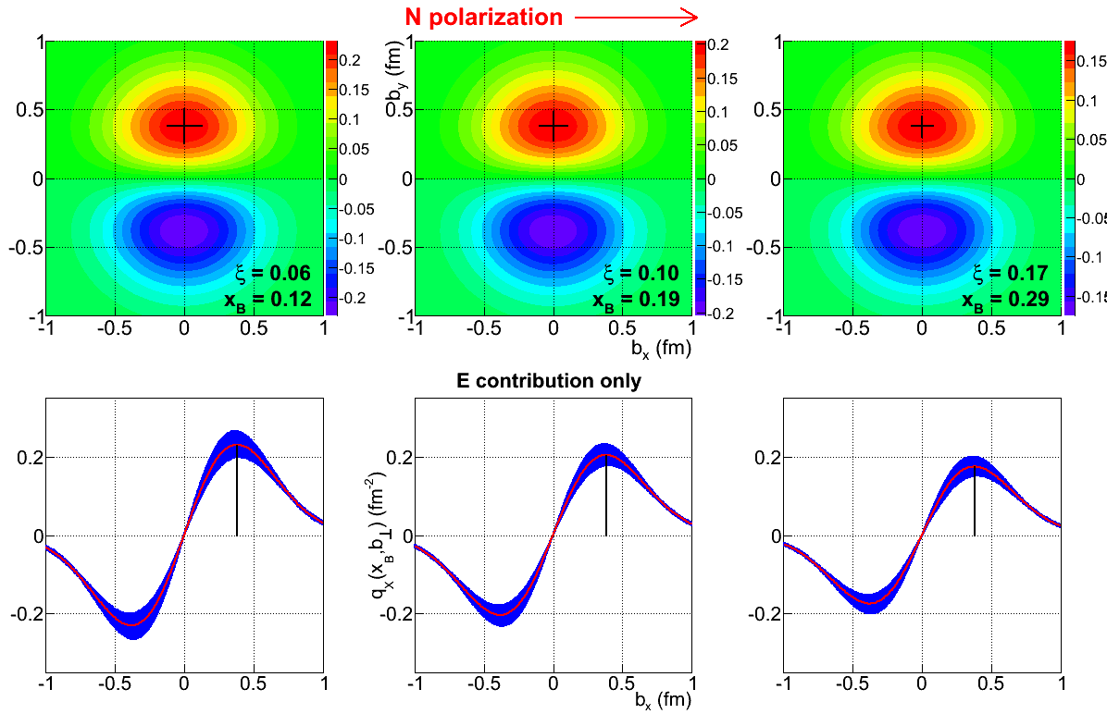
Parton density in transversely polarized nucleon
Parton density in a
transversely polarized nucleon is not experimentally accessible
What is directly accessible is the Fourier transform
Contribution of E &H
Contribution of E

Slide 18
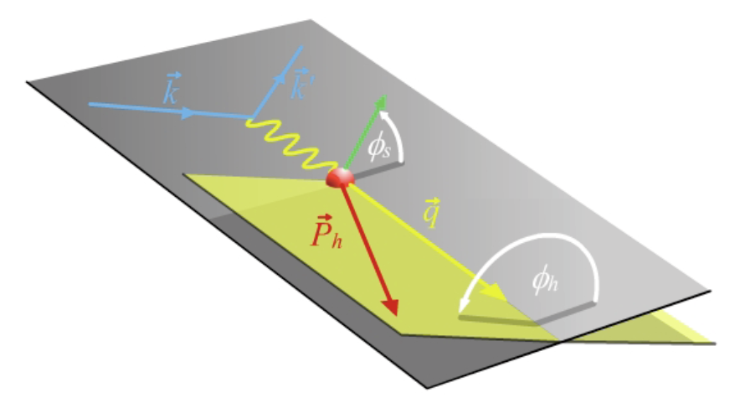
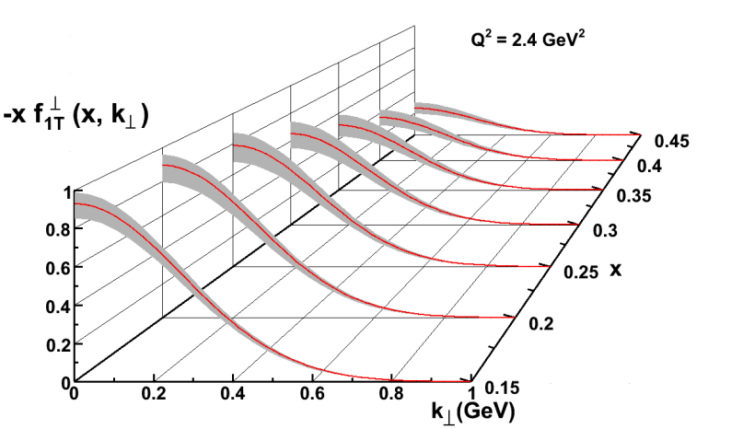
SIDIS Electroproduction of Pions
Separate Sivers and Collins effects
Sivers angle, effect in distribution function: (φ_{h}-φ_{s})
Collins angle, effect in fragmentation function: (φ_{h}+φ_{s})
Previous data from HERMES,COMPASS
New landscape of TMD distributions
Access to orbital angular momentum
target angle
hadron angle
Scattering Plane

Slide 19
The Multi-Hall SIDIS Program at 12 GeV
M. Aghasyan, K. Allada, H. Avakian, F. Benmokhtar, E. Cisbani, J-P. Chen, M. Contalbrigo, D. Dutta, R. Ent, D. Gaskell, H. Gao, K. Griffioen, K. Hafidi, J. Huang, X. Jiang, K. Joo, N. Kalantarians, Z-E. Meziani, M. Mirazita, H. Mkrtchyan, L.L. Pappalardo, A. Prokudin, A. Puckett, P. Rossi, X. Qian, Y. Qiang, B. Wojtsekhowski
for the Jlab SIDIS working group
The complete mapping of the multi-dimensional SIDIS phase space will allow a comprehensive study of the TMDs and the transition to the perturbative regime.
Flavor separation will be possible by the use of different target nucleons and the detection of final state hadrons.
Measurements with pions and kaons in the final state will also provide important information on the hadronization mechanism in general and on the role of spin-orbit correlations in the fragmentation in particular.
Higher-twist effects will be present in both TMDs and fragmentation processes due to the still relatively low Q² range accessible at JLab, and can apart from contributing to leading-twist observables also lead to observable asymmetries vanishing at leading twist. These are worth studying in themselves and provide important information on quark-gluon correlations.

Slide 20
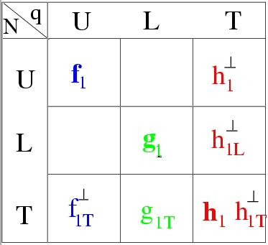
JLab TMD Proton Program @ 12 GeV
Leading twist TMD parton distributions: information on correlations between quark orbital motion and spin
CLAS12
Hall C
Hall A
Quark spin polarization
E12-06-112: π⁺,π⁻,π⁰
E12-09-008: K⁺, K⁻,K⁰
E12-09-017: π⁺,π⁻, K⁺,K⁻
C12-11-102: π⁰
HMS
SHMS
E12-07-107: π⁺,π⁻,π⁰
E12-09-009: K⁺,K⁻,K⁰
Nucleon polarization
C12-11-111: π⁺,π⁻,π⁰
K⁺, K⁻
C12-11-108: π⁺,π⁻
Solid
H₂, NH₃, HD
H₂
NH₃
The TMD program will map the 4D phase space in Q², x, z, P_{T}

Slide 21
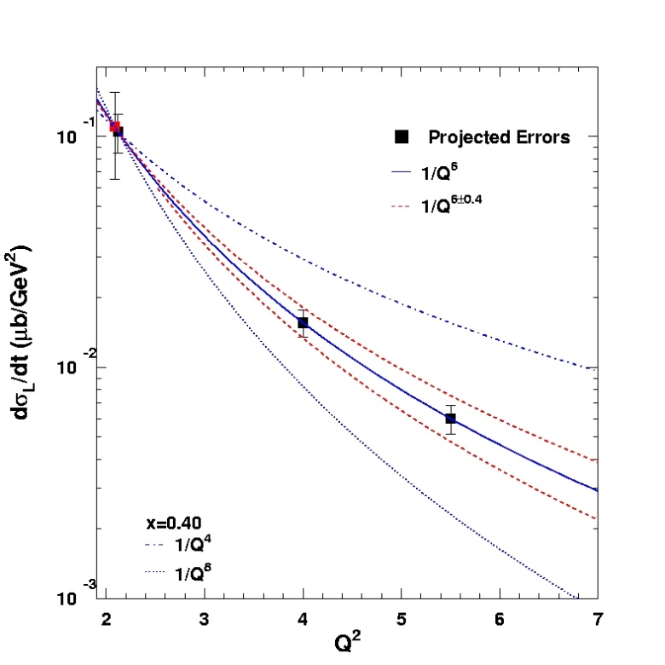
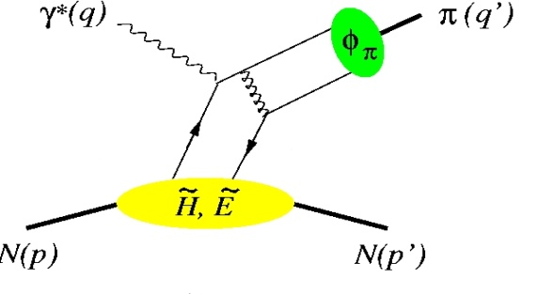
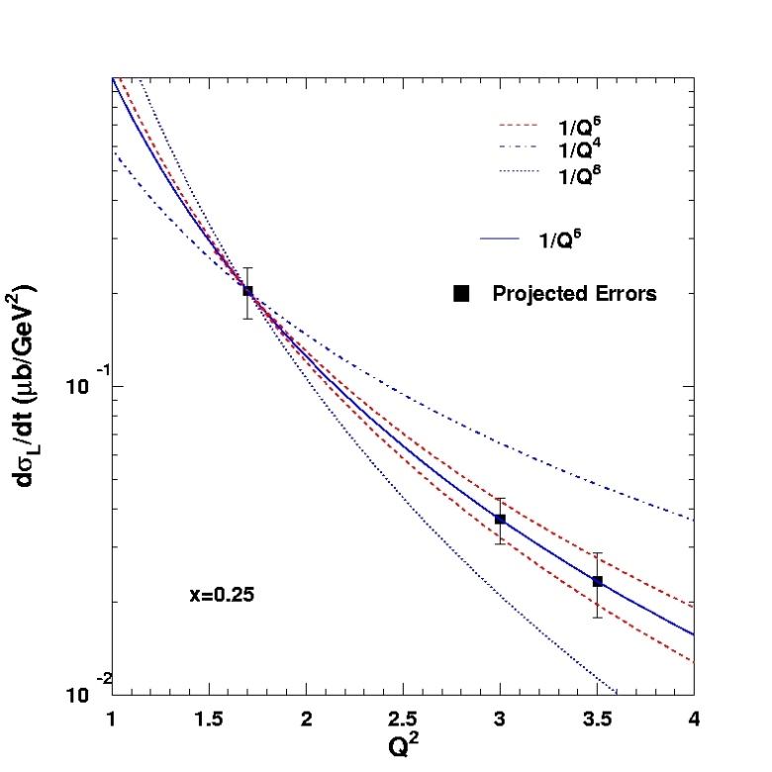
Factorization Tests in π⁺ and K⁺ Electroproduction
σ = Γ(σ_{Τ} + εσ_{L} + ε cos(2φ)σ_{TT} + [ε(ε+1)/2]^{1/2}cos(φ)σ_{LT})
π, K, etc.
p(e,e’π⁺)n
φ
Hard Scattering
Q⁻⁴
Fit: 1/Q^{n}
GPD
Q⁻⁶
Q⁻⁸
One of the most stringent tests of factorization is the Q² dependence of the π and K electroproduction cross section
σ_{L} scales to leading order as Q⁻⁶
x_{B} = 0.40
p(e,e’K⁺)Λ
Q⁻⁶
Q⁻⁴
Experimental validation of factorization essential for reliable interpretation of results from the JLab GPD program at 12 GeV for meson electroproduction
Q⁻⁸
x_{B}=0.25
K and π together provide quasi model-independent study

Slide 22
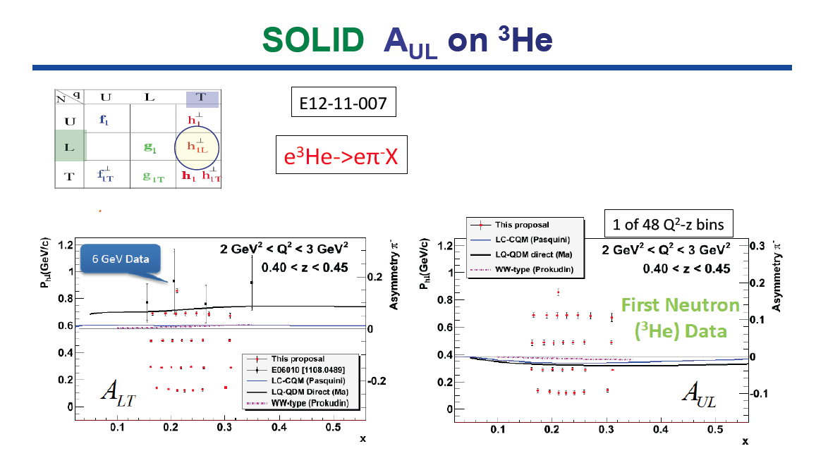
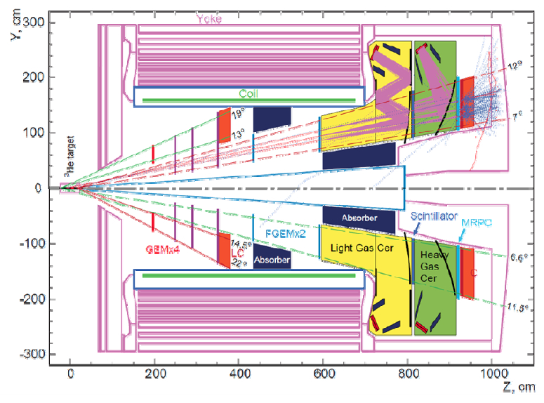

Slide 23
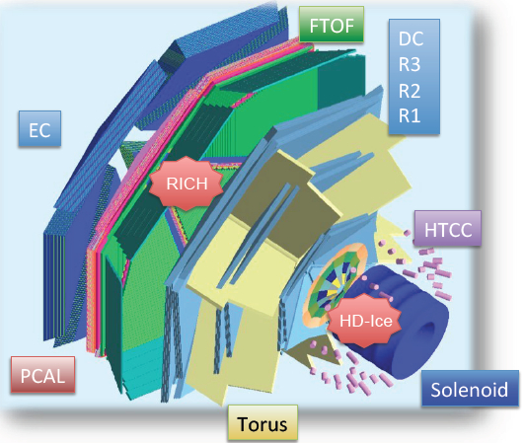
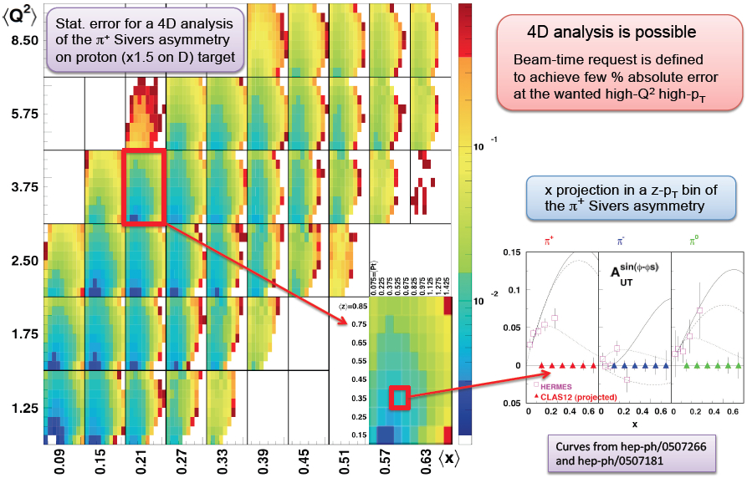
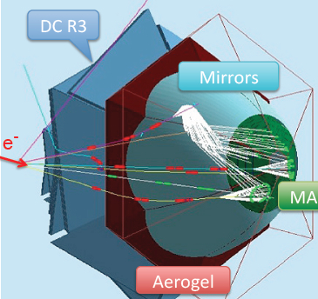

Slide 24
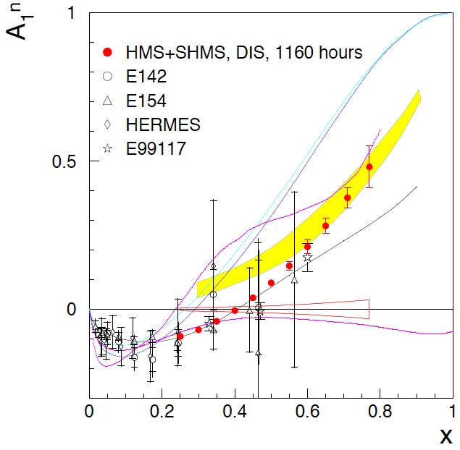






Longitudinal Structure
NSAC milestone HP14 (2018)
9 Experiments @12 GeV JLab
JLab@12 GeV has
unique capability to
define the valence region
p
d
SU(6)
Inclusive A₁
Helicity
conservation
Scalar diquark
+BONuS 12 GeV Projected

Slide 25




The Incomplete Nucleon: Spin Puzzle
ΔΣ ~ 0.25
ΔG small
L_{q}?
1
1
ΔΣ
+
L_{q}
+
J_{g}
=
2
2
Access to orbital momentum
12 GeV projections:
transverse momentum maps
12 GeV projections:
transverse spatial maps

Slide 26
Conclusions
Several detectors under construction or proposed – CLAS12, SBS, SOLID to carry out 3D nucleon imaging program
Jlab12 has a well defined and broad experimental program to measure DVCS in the full phase space available at 12 GeV: Q² < 9GeV², 0.5<x_{B}< 0.7, -t < 2.5GeV².
CLAS12 is the major detector system to measure DVCS cross section and target polarization observables
High statistics data are expected from Hall A for DVCS cross sections in reduced kinematics
JLab12 has a broad program defined to measure TMDs in 4D phase space Q², x_{B}, z, P_{T}
Use of full acceptance detectors with excellent Kaon identification essential for complete program
Use of polarized proton (NH₃) and neutron (ND₃, ³He) targets with longitudinal and transverse polarization are available for complete program

Slide 27

CLAS12 DVCS/BH Beam asymmetries A_{LU} neutrons
E12-11-003
t=-0.35GeV²
Q²=2.75GeV² x_{B}=0.225
S. Niccolai
Total of 588 bins in t, Q², x_{B}, φ
A_{UL}
A_{LU} is highly sensitive to d-quark helicity content of the neutron.

Slide 28

SIDIS and Transverse Momentum Distribution
SIDIS cross section in leading twist:
e’
π,K
e
The 8 structure functions factorize into TMD parton distributions, fragmentation functions, and hard parts:
Integrals over transverse momentum of initial and scattered parton
A full program to extract L.T. TMDs from measurements requires separation of the structure function using polarization, and coverage of a large range in x, z, P_{T} along with sensitivity to Q², and the flavor separation in u, d, s quarks.

Slide 29


Diffraction and Imaging
Huygens-Kichhol-Fresnel principle
Q = k – k’
The interface pattern is given by
superposition of spherical wavelets

Slide 30

Physical content of GPDs H, E
Nucleon energy-momentum tensor of q flavored quarks:
(Ji’s sum for t=0)
Fourier transformation relates J(t) to the quark angular momentum distribution in b_{T} space.
M₂(t): Mass distribution in b_{T} space
d₂(t): Pressure and force distribution on quarks.
K. Goeke et al., PRD75, 2094021 (2007)

Slide 31



DVCS reaction frame
Preliminary
CLAS DVCS target spin asymmetry results
■ - preliminary results of eg1-dvcs
■ - pioneering measurements from CLAS-eg1b
□ - results from HERMES
Preliminary
A_{UL}
Preliminary
Phys.Lett. B689 (2010) 156-162
Preliminary
arXiv:1003.0307 [hep-ph]

Slide 32

Extraction of Compton Form Factors from expected DVCS data
In general, 8 GPD quantities accessible
Compton Form Factors, (CFF)
Phys.Lett. B689 (2010) 156-162
arXiv:1003.0307 [hep-ph]
DVCS : golden
channel
anticipated
leading Twist
dominance
already at low Q²
Given the well-established
LT-LO DVCS+BH amplitude

